Slide 1
International Financial Accounting
Dr Sean Power, ACA

Slide 2
About
Lecturer: Dr Sean Power, ACA
Email: s.power@tbs-education.fr
Background

Slide 3
Learning plan
Session 1 – Introduction & context
Session 2 – Balance sheet
Session 3 – Income statement
Session 4 – Cash flow statement
Session 5 – Notes to the financial statements

Slide 4
Session 1
Introduction & context

Slide 5
Session 1: Context
Why learn international accounting rules?
Group project info
International Accounting Standards Board (IASB)
The Conceptual Framework
Presentation of Financial Statements (IAS 1)
Group accounting – core concepts

Slide 6
Why learn international accounting?

Slide 7
Why learn international accounting?
International accounting rules adopted in over 120 countries around the world
Some of the largest companies in the world are using these rules to prepare their financial statements
Accounting is how businesses signal their financial position & performance to the market
A knowledge of accounting helps you to interpret these signals
Accounting data underpins many finance techniques & processes
Knowing how the figures were constructed allows you to apply the data in a more meaningful way
CFA
Screening questions

Slide 8
Session Goals
In these sessions, my goal is deepen your knowledge of financial statements (& accounting data)
Improve your ability to interpret financial statements
Understand the accounting data you inevitably will work with in future
Learn how the figures are constructed from an accountant’s perspective
Tailored module to be relevant to finance professionals – rather than accountants
Be able to hold a conversation with an accountant at the office watercooler!

Slide 9
Group project

Slide 10
Group Project
Groups (of 2) & group project available on Campus
You have until Friday 15th October 2021 by 17:00 to submit project on Campus
Max 6 pages report (excluding title & index pages)
Select 2 companies in same industry ; not financial services
Perform a basic accounting analysis:
Show knowledge of accounting rules
Compare & contrast the details of their accounting policies
Consider how the policies impact on the financial statements & evaluation of the companies

Slide 11
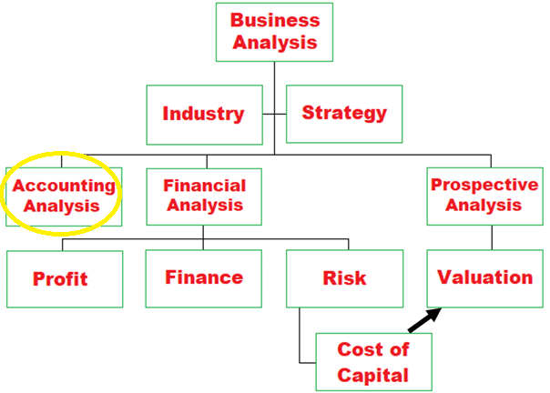
Business analysis

Slide 12
Accounting analysis
Accounting policies & estimates
How well is the company capturing the reality of its business transactions & events?
What level of distortion is there within the accounts?
Review the Notes to the financial statements
i.e. Note 1 – Accounting Policies

Slide 13
Factors Influencing Accounting Quality
Despite the existence of accounting regulation (numerous accounting standards) & external audit there will be an element of bias in the accounts
Noise and Bias
Forecast error
Reporting choices by corporate manager
Rigidity in accounting rules

Slide 14
Accounting Choices - Motives
Managers may have a variety of incentives to exercise their accounting discretion to achieve certain objectives:
Accounting based debt covenants
Management compensation
Corporate control contests
Tax
Regulatory considerations
Capital market considerations

Slide 15
Financial Shenanigans
Discovery is unlikely
Penalties small
Accounting rules can be broad/subjective
Internal controls may be weak
Most prone
High growth companies
Weak companies
Private companies
Newly public companies
Recent example: Wirecard https://www.wsj.com/articles/how-germanys-sec-dismissed-a-decade-of-warnings-about-wirecard-11594907212
Notes:
https://www.wsj.com/articles/how-germanys-sec-dismissed-a-decade-of-warnings-about-wirecard-11594907212

Slide 16
Accounting Analysis Steps
Identify potential red flags –
Unexplained changes
Unusual increases
Unexpected large asset write offs
4th quarter adjustments ( Aggressive management)
Qualified audit opinion/ changes in auditors
Related party transactions
Use red flags to probe further - not as an end point in itself

Slide 17
Techniques to Distort
Choice of accounting treatment permitted under IFRS
Depreciation calculation
Revenue recognition policy
Cost versus Fair Value measurement
Timing the adoption of a new accounting standard
Adjusting through income statement or retrospective adjustment to balance sheet equity
Decision not to implement a new standard on grounds of materiality

Slide 18
Techniques to Distort
3. Judgement calls: depreciation, allowance for bad debts, asset valuation, impairments
Classificatory management
Classifying items between Profit & Loss or Other Comprehensive Income

Slide 19
Techniques to Distort
Structuring transactions to achieve desired accounting outcome
Timing sales of assets during period where tax carry back / forward rules apply
Altering legal form in an attempt to manipulate accounting treatment (US bank & loan book)
Managing the transparency of the information
Real production & investment decisions i.e. cutting back on research & development expenditure

Slide 20
International Accounting Standards Board (IASB)

Slide 21
Why standardise accounting regulation?
The world’s two main standard setting bodies are:
United States - Financial Accounting Standards Board (FASB)
International – International Accounting Standards Board (IASB)
The IASB’s accounting rules are International Reporting Standards (IFRS)
IFRS has been adopted by over 120 countries around the world
The FASB’s accounting rules are Generally Accepted Accounting Principles (US GAAP)
US GAAP is applied within the United States
The United States contains some of the world’s largest capital markets
The non-adoption of IFRS by the US is a major limitation to the global adoption of IFRS

Slide 22
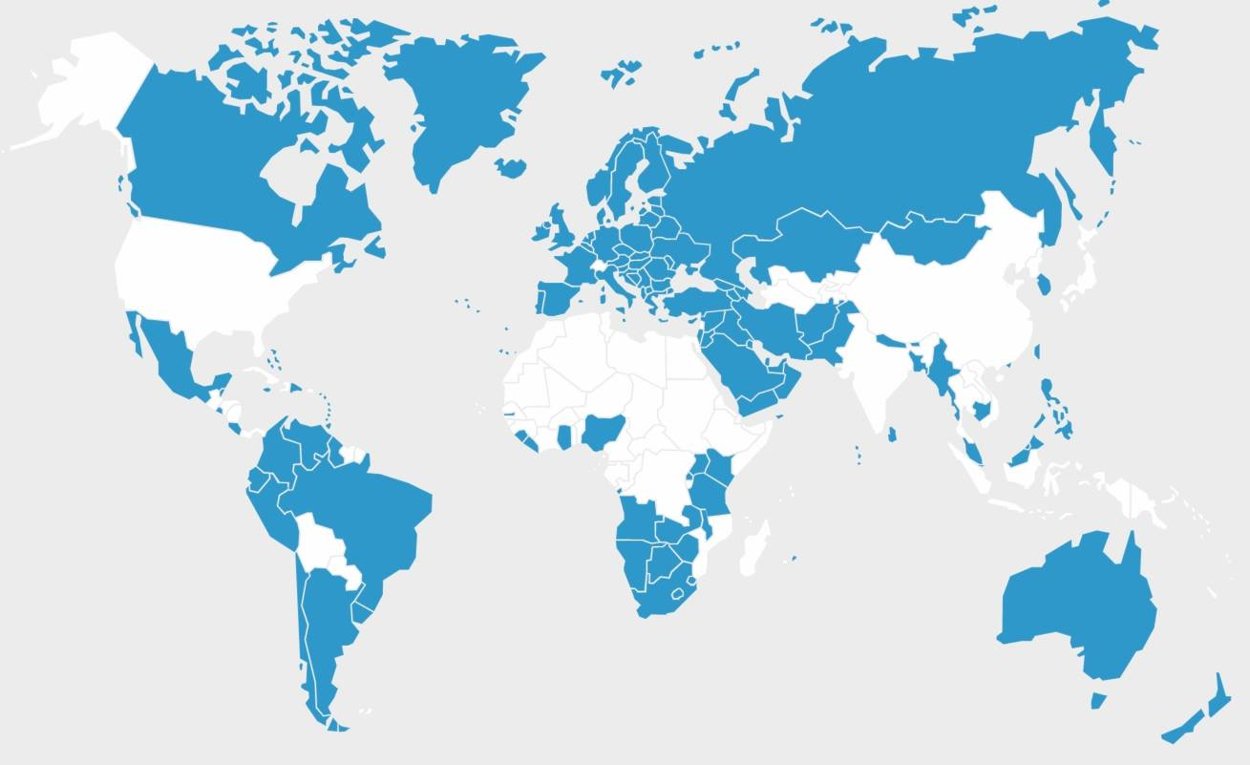
Why standardise accounting regulation?
Countries that have adopted IFRS for listed companies (Source: IASB, 2018)

Slide 23
The Rise of Accounting & Accounting Regulation
The FASB and IASB have worked to converge their accounting regimes into a single, high quality set of accounting standards
But what are the benefits to standardisation?
It aids international investment
It helps multinational companies cross-list in multiple countries
It helps professional accountants and auditors to become internationally mobile

Slide 24

Brief history of standard setting bodies

Slide 25

The United States

Slide 26
The histories of the world’s major standard setting bodies: The United States
The US was the first country to take significant steps towards codification and mandatory application of accounting rules (regulation)
In the 1920s, researchers empirically examined accounting methods and doctrines being applied by accountants
They described conventions/doctrines such as conservatism, materiality, consistency, the entity assumption and matching principle
This work was important in 1929 when the US stock market crashed

Slide 27
The histories of the world’s major standard setting bodies: The United States
The stock market crash of 1929 was the impetus for accounting regulation
NYSE requested accounting profession to compile list of broadly used accounting principles
Securities legislation passed in 1933 and 1934
Led to creation of US Securities and Exchange Commission (SEC)
Securities Exchange Act, 1934, requires disclosure of stipulated information by companies seeking to trade their securities
The SEC is provided the authority to develop accounting regulation
The SEC delegates this authority to the accounting profession
Accounting profession publishes: A Statement of Accounting Principles

Slide 28
The histories of the world’s major standard setting bodies: The United States
From Wild West to mandatory regulation:
Finally, in 1973, the SEC delegates the task of developing accounting standards to the Financial Accounting Standards Board (FASB)
The FASB established as a private body acting in the public interest
But not entirely independent: SEC can over-rule the decisions of the FASB

Slide 29

The United Kingdom
(and internationally)

Slide 30
The histories of the world’s major standard setting bodies: The United Kingdom
The United Kingdom comparatively slow to introduce codified accounting regulation
It was only in the 1970s that the Accounting Standards Steering Committee was established
This body would later become the IASC and then the IASB
Environment in 1960s and 1970s allowed for the creation of an international accountancy body:
1960s increasing number of mergers and acquisitions of European companies by American companies
The UK committed to joining the European Economic Community in 1972

Slide 31
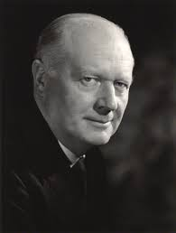
The histories of the world’s major standard setting bodies: The United Kingdom
In the context of this environment:
Henry Benson elected Chairman of ICAEW
Benson would be a key figure in the creation of international accounting regulation
Benson established closer relations with professional accountancy bodies in the United States and Canada to:
Advance the interests of the profession as a whole
Establish a common approach to accounting & auditing problems

Slide 32
The histories of the world’s major standard setting bodies: The United Kingdom
February 1967: the three bodies (UK, US and Canada) jointly formed the Accountants’ International Study Group
Group publishes papers on accounting topics & develops its own doctrinal framework
Becomes the basis for the creation of the International Accounting Standards Committee (IASC) in 1973

Slide 33
The histories of the world’s major standard setting bodies: The United Kingdom
In 2001, the IASC restructures and becomes the International Accounting Standards Board (IASB)
The new structure considered to make body more independent and rigorous
IASB adopts all of the existing IASs issued by the IASC
In the future, it will publish new regulations in the form of International Financial Reporting Standards (IFRS)
The policy of the IASB shifts from convergence to standardisation:
The implementation of a single set of high quality, global standards.

Slide 34
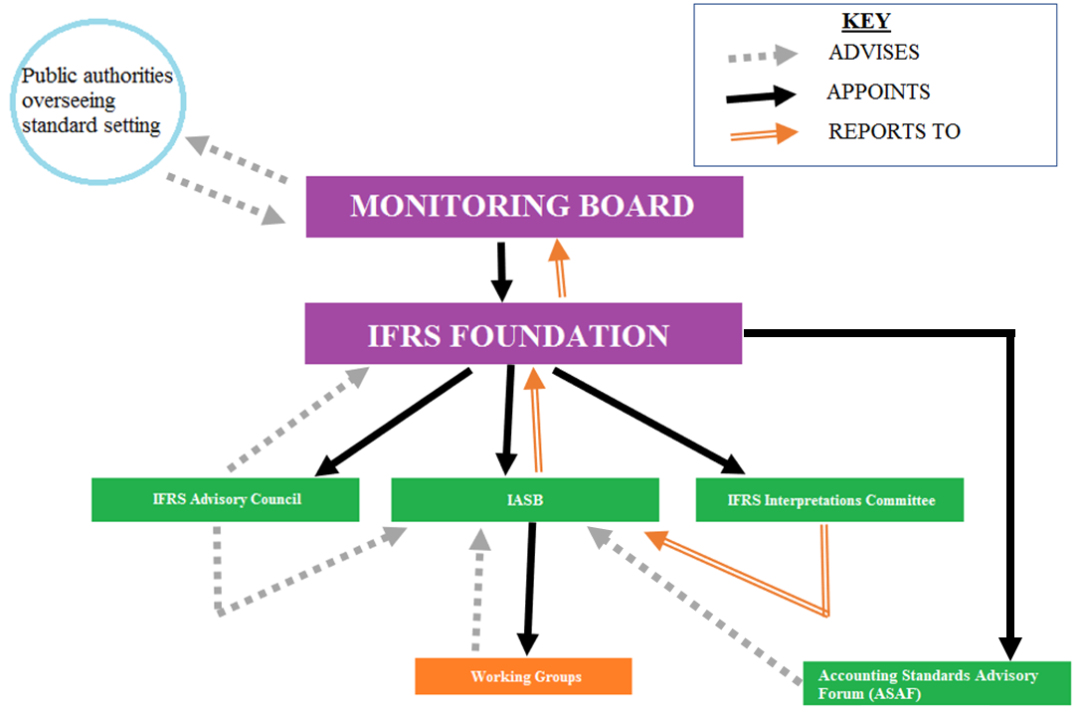
The structure of the IASB

Slide 35
The IASB
Comprises of a maximum of 16 members.
IASB members must comprise a group of people representing the best combination of technical skills and background experience of relevant international business and market conditions in order to contribute to the development of high quality, global accounting standards.
To approve an IFRS, 10 out of 16 IASB members must vote in favour of it.
The IASB has the authority to develop accounting standards but it does not have the power to enforce those standards as an independent body.
This creates an issue: different countries that have adopted IFRS may enforce the requirements of IFRS in a less formal manner.
Case Study 1.1.1

Slide 36
The structure of the IASB
Case Study 1.1.1: Société Générale (France)
In January 2008, French bank, Société Générale, lost €6.4 billion as part of a fraud.
The bank decided to shift the loss, which occurred in 2008, to the 2007 financial statements and to offset it against a €1.5 billion profit earned by a trader who concealed bets in financial futures markets.
Société Générale justified its accounting practice by invoking the ‘true and fair’ provision of international accounting standards.
‘The true and fair’ provision allows companies to depart from the accounting rules, in extremely rare circumstances, where management concludes that compliance with the rules would be so misleading that it would conflict with the objective of financial statements.
This highlights a number of issues with international accounting standards:
The IASB is an independent body: it may write the accounting rules but it has no power to enforce them.
Further, it raises the question: can international accounting standards be consistently applied in countries around the world?

Slide 37
Conceptual Framework

Slide 38
Status & Purpose of CFW
CFW describes the objective of and concepts for financial reporting
The CFW is not a Standard
Nothing in the CFW overrides any Standard or any requirement in a Standard

Slide 39

Objective of general purpose financial reporting
The objective of general purpose financial reporting is:
to provide financial info about the reporting entity that is useful
to existing & potential investors, lenders & other creditors
in making decisions relating to providing resources to the entity

Slide 40
Qualitative characteristics of useful info
Details types of information that would be useful to users to make capital allocation decisions
Linked to the objective of general purpose financial reporting
Divided into 2 categories:
Fundamental qualitative characteristics of useful financial info
Enhancing qualitative characteristics of useful financial info
Notes:
Enhancing characteristics enhance usefulness of info that is relevant and faithfully represented
Enhancing characteristics (individually or as a group) can’t make info useful if it is irrelevant or not faithfully represented

Slide 41
Fundamental qualitative characteristics
Relevance
Predictive value
Confirmatory value
Materiality
Faithful representation
Complete
Neutral
Prudence
Free from error

Slide 42
Enhancing qualitative characteristics
Enhancing qualitative characteristics:
Comparability
Verifiability
Timeliness
Understandability

Slide 43
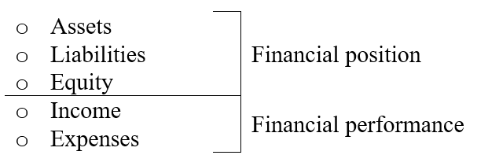
Elements of financial statements
The elements of the financial statements are:

Slide 44

Definition of an asset
An asset is a present economic resource controlled by the entity as a result of past events
An economic resource is a right that has the potential to produce economic benefits

Slide 45

Definition of a liability
A liability is a present obligation of the entity to transfer an economic resource as a result of past events

Slide 46

Quiz
An up and coming golf brand signs a contract with a popular professional golfer, Simba Forest, to wear their brand during an upcoming tour
How would the accountant of the brand think about this contract?

Slide 47
Answer

Slide 48
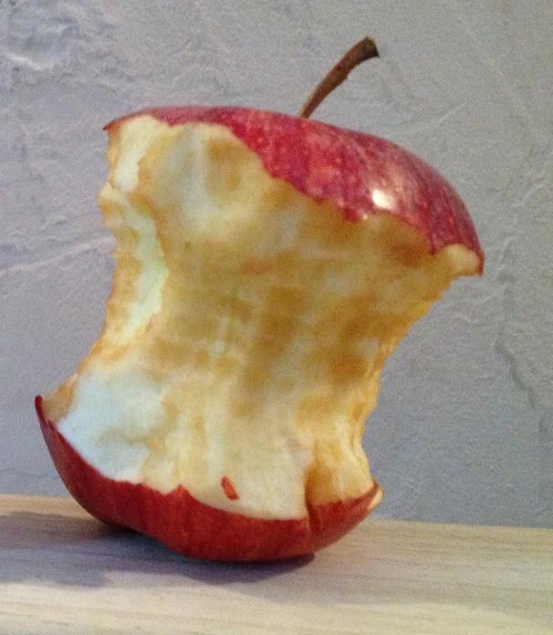
Definition of equity
Equity is the residual interest in the assets of the entity after deducting all of its liabilities

Slide 49
Definition of income and expenses
Income:
Income is increases in assets, or decreases in liabilities
that result in increases in equity
other than those relating to contributions from holders of equity claims
Expenses:
Expenses are decreases in assets, or increases in liabilities
that result in decreases in equity
other than those relating to distributions to holders of equity claims
Notes:
Will a dividend ever appear in the income statement ?

Slide 50
Presentation of financial statements (IAS 1)

Slide 51
IAS 1
IAS 1 is different in nature to the other IFRSs:
IAS 1 outlines the broad structure of the financial statements
Other IFRSs fill in the detail within the financial statements: the recognition, measurement & disclosure requirements
IAS 1 takes priority over the IASB’s Conceptual Framework for Financial Reporting where any conflict arises
Discussing the presentation requirements of IAS 1 can be abstract
There are IAS 1 templates for the presentation of the balance sheet, income statement and statement of changes in equity in the notes
These templates can be an effective way to review the structure and presentation requirements of IAS 1

Slide 52
The financial statements
A complete set of financial statements comprises of:
Statement of financial position at the end of the reporting period
Statement of profit or loss and other comprehensive income for the period.
Statement of changes in equity for the period
Statement of cash flows for the period
Notes to the financial statements – comprising of significant accounting policies and other explanatory information

Slide 53
Balance sheet
IAS 1 does not prescribe any particular balance sheet format or structure.
For example, it is acceptable for entities to apply either the horizontal or vertical formats of balance sheets.
The standard prescribes minimum requirements for separate line items on the balance sheet
Accountants allowed flexibility to provide additional line items, headings and sub-headings

Slide 54
Balance sheet
Current asset: an asset should be classified as current if any of the following criteria are met:
The entity expects to realise the asset, or intends to sell or consume the asset, in its ordinary operating cycle.
The entity holds the asset primarily for the purpose of trade.
The entity expects to realise the asset within 12 months of the balance sheet date.
The asset is cash or cash equivalents.
Non-current asset: an asset should be classified as non-current if it fails to meet the criteria for a current asset.

Slide 55
Balance sheet
Current liability: A liability should be classified as current if any of the following criteria are met:
The liability is expected to be settled in the entity’s normal operating cycle.
The liability is held primarily for the purpose of being traded.
The liability is due to be settled within 12 months after the balance sheet date.
The entity does not have an unconditional right to defer settlement of the liability for at least 12 months after the balance sheet date.
Non-current liability: A liability should be classified as non-current if it fails to meet the criteria for a current liability.

Slide 56
Understanding sections (components) of income statement
Analysts and investors frequently rely on income statement information to evaluate the performance of firms and to make investment decisions.
There are a number of IFRS requirements that regulate how accountants should prepare and present income statement information.
Two examples of accounting standards that guide the preparation of the income statement are IAS 1 and IAS 33 (Earnings Per Share)

Slide 57
Income statement
The IASB requires the income statement to capture all-inclusive, total comprehensive income
This means there are distinct parts of the income statement:
Parts of income statement: | Characteristics:
Profit or loss (P&L) | Realised gains or losses ; recurring in nature
+
Other Comprehensive Income (OCI) | Unrealised gains or losses ; typically non-recurring
=
Total Comprehensive Income
Notes:
Tie this to a discussion of finance & valuation. Think about how finance professionals value a company using a FCF model: the forecasts is usually primarily driven by a growth rate. They can’t come up with forecast forever, so at some point they use a perpetuity to calculate the Continuing Value or Terminal Value.
But if non-recurring items are included in the base figures that they are forecasting & calculating perpetuities with – this will result an inaccurate valuation.
Because it is assuming the non-recurring item continues each year over the forecast period.

Slide 58
Income statement
There are two opposing views on the relative superiority of P&L and total comprehensive income as metrics of firm performance.
Some believe total comprehensive income is the superior metric of firm performance
Others believe the profit or loss (P&L), because it represents realised gains and losses which are typically recurring in nature, is the superior metric
These opposing views impacted on the requirements of IAS 1 for the structure and presentation of the balance sheet
Option to present a single, combined income statement or separate statements (see next slide)

Slide 59
Income statement
IAS 1 gives preparer the option to present components of the income statement as either:
A single (combined) ‘statement of profit or loss and other comprehensive income’
OR
Two separate statements:
Statement for the profit of loss (P&L) &
Statement for other comprehensive income (OCI)

Slide 60
Line items
The following line items to appear separately on the face of the income statement:
Revenue
Finance costs
Share of profit or loss in an associate or jointed venture (accounted for under the equity method)
Tax expense
A single line for the total profit or loss from discontinued operations (under IFRS 5)
Accountants have flexibility to present additional line items, headings and subtotals that are relevant to an understanding of an entity’s financial performance

Slide 61
Totals
In addition to the line items, IAS 1 requires certain totals to be displayed on the face of the income statement:
Total profit or loss for the period (P&L total)
Total other comprehensive income for the period (OCI total)
Total comprehensive income for the period

Slide 62
Totals …cont’d
Total figures must be split on face of income statement between the portion that belongs to equity holders of the parent company & non-controlling interests
For example:
Total profit of loss (P&L) attributable to:
Equity holders of parent Non-controlling interests
Total comprehensive income attributable to:
Equity holders of parent Non-controlling interests

Slide 63
Non-controlling interest
Income statement totals split between:
Equity holders of parent Non-controlling interests
Balance sheet has an equity account called “Non-controlling interest”
Annual reports of large companies contain 2 sets of financial statements:
Parent company financial statements Group financial statements
Can you explain the above? Important for analysts to know !

Slide 64
Group accounting
- The impact of acquiring control of another entity on the financial statements

Slide 65
Introduction
Reporting entities may acquire interests in other entities by investing in their equity (i.e. buying shares in other companies)
Under IFRS, the information and accounting requirements for these investments depends on the extent to which the reporting entity can influence or control the investee entity.
The more influence reporting entity can exert over investee entity, the more comprehensive the accounting information required
Necessary to address the accounting issues or pitfalls that can arise from companies being separate legal entities i.e. off-balance sheet financing

Slide 66
Parent exercises CONTROL
= Subsidiary
What is meant by ‘control’?
IFRS 10 contains a detailed definition of ‘control’
Basic assumption: control where investor hold > 50% of investee’s share capital
IFRS 10 & IFRS 3 apply
Account for this investment using the “Acquisition Method”:
100% of the assets & liabilities of the subsidiary &
100% of the income and expenses

Slide 67
Parent does NOT exercise CONTROL
Larger investments (i.e. associates and joint ventures)
Acquirer exercises “significant influence” but not “control”
Basic assumption: holds ≥ 20% and ≤ 50% of investee’s share capital
Account for this investment using the “Equity Method”:
- Initial investment + the investing group’s share of the post-acquisition increase in those companies’ net assets;
- Investing group’s share of profit after tax is included in consolidated SOCI;

Slide 68
Parent does NOT exercise CONTROL
Minor investments
= “Simple (or Trade) Investment”
Basic assumption: investor holds < 20% of investee’s share capital
These are dealt with as financial assets in accordance with IFRS 9:
Dividends received recorded as income in the consolidated income statement

Slide 69
Accounting for interests in other entities
Accounting treatment depends on the extent of influence or control
 | Simple Investment | Associate Interest | Joint Arrangement | Subsidiary Interest
Ownership: | < 20% | 20 – 49% | Joint | ≥ 50%
Accounting Standard: | IFRS 9 | IAS 28 | IFRS 11 | IFRS 3 / IFRS 10
Accounting Treatment: | At fair value. Separate consolidated financial statements not required. | Equity method | Joint operation – in accordance with relevant IFRSs. Joint venture – equity method. | Consolidation – acquisition method.

Slide 70
Separate financial statements of parent
If a parent company owns a “subsidiary”, must prepare:
Consolidated/group accounts
Its own, unconsolidated, financial statements
Let’s look at accounting for subsidiaries – where the investor entity controls the investee entity

Slide 71
Definition of “group”
A group is defined as a parent company and one or more subsidiaries.
Group accounts are prepared primarily for the shareholders of the parent company.

Slide 72
Group Accounts – Core Principles
Group accounts add:
100% of assets, liabilities, income, expenses and equity for each member of the group
But the core objective when preparing group accounts is to include only elements that have meaning from the perspective of the group
Therefore must exclude:
Sales that were not made to external parties
Unrealised profits (e.g. profits earned on intra-group sales, where the goods have not yet been sold to external parties)
Intra-group balances (e.g. amounts owed between one member of the group and another)

Slide 73
Group Accounts – Core Principles
Group accounts will include 100% of the assets, liabilities, income and expenses of subsidiaries.
But accounts are prepared primarily for the shareholders of the parent company
If a subsidiary is not wholly owned, the parent company shareholders need to know that some of the subsidiary’s net assets are owned by external parties
These parties are known as non-controlling interests (NCI) ; used to be referred to as “Minority Interests”
Overall objective of group accounts is to include all elements (i.e. assets, liabilities etc.) of all members of the group, and:
to exclude all transactions, unrealised profits and balances that are intra-group
to note separately the claims of non-controlling interests

Slide 74
IFRS 3: Business Combinations
A business combination takes place when an acquirer obtains control of one or more businesses
There are two sides to this event:
Payment being made – normally in cash or equity of acquirer
In exchange: acquirer obtains ownership of assets & responsibility for liabilities of acquired entity
IFRS 3 requires both of these be measured at FAIR VALUE

Slide 75
Group example
Let’s look at the group example

Slide 76
Group example
Can we just add the 2 balance sheets together?
 | RhinoAir | AerLeadus |  | CONSOLIDATED
ASSETS
Plant & Machinery | 600,000 | 150,000
- Cost | 1,000,000 | 200,000
- Acc Depreciation | -400,000 | -50,000
Investment in Aer Leadus | 170,000 | 0
Goodwill
Current Assets | 800,000 | 140,000
 | 1,570,000 | 290,000
EQUITY & LIABILITIES
Share Capital | 100,000 | 100,000
Share Premium | 150,000 | 10,000
NDR | 400,000 | 0
Retained Profit | 650,000 | 45,000
 | 1,300,000 | 155,000
Non-Controlling Interests
Long Term Loan | 270,000 | 135,000
 | 1,570,000 | 290,000

Slide 77
Consolidation issue #1
Why can’t we just add the parent + subsidiary financial statements together?
Issue:
At acquisition date: the assets & liabilities of the subsidiary are reflected in 3 places!
Solution:
We only want the original measures of the assets & liabilities
We offset the duplicates:
Investment in subsidiary (in parent’s balance sheet)
At-acquisition equity of subsidiary (in subsidiary’s balance sheet)

Slide 78
Consolidation issue #2
When we offset the 2 items, they may not offset exactly
Different measurement bases:
Investment in subsidiary – what directors were prepared to pay
Equity of subsidiary at acquisition – measured under accounting rules (book value)
What does the difference represent?
What should we do with the difference?

Slide 79
IFRS 3 - Goodwill
A new asset is created called “Goodwill”
Why did the directors pay more than the identifiable net assets at fair value?
Synergies?
Intangible value?
Goodwill accounted for under IFRS 3
Not depreciated/amortised but tested for impairment annually

Slide 80
IFRS 3 - Goodwill
Criticisms:
Can sit on balance sheet (& be included in total assets) for long period – not amortized
What is it? What does the asset reflect?
Is it a productive asset? Does it reflect future economic benefits?
What should analysts do with it?

Slide 81
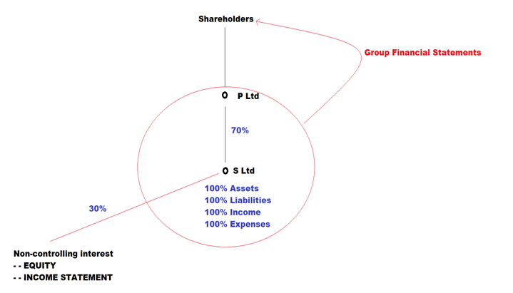
Group Structure
Consolidation rules attempt to address complexities of accounting for groups

Slide 82
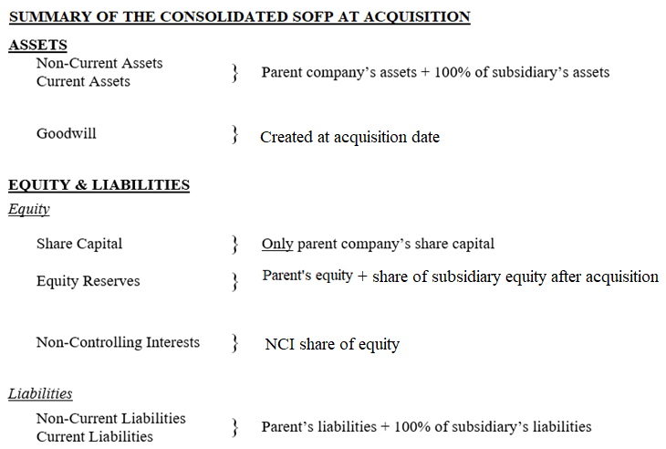
Group Balance Sheet

Slide 83
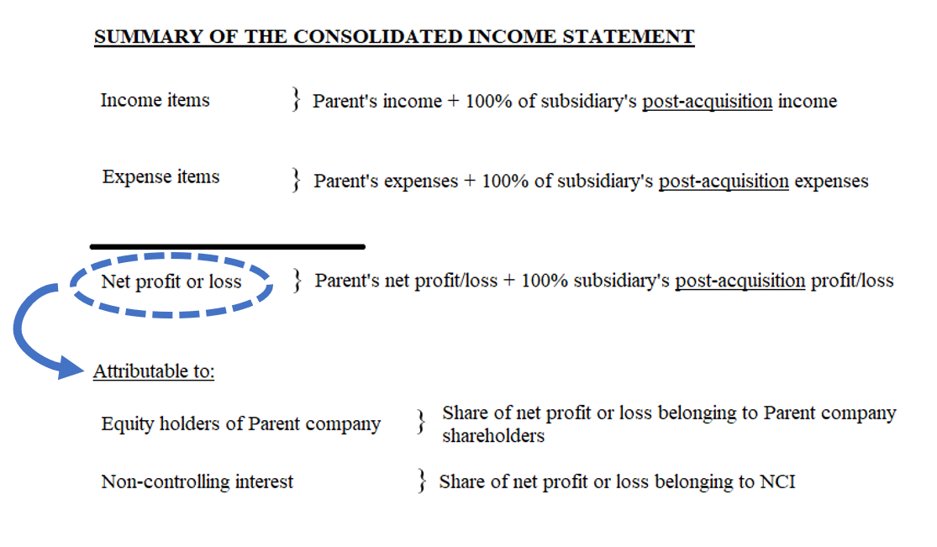
Group income statement

